Slide 1


Summer Internship Training On AWS.
Done Under The Guidance Of: Gokboru Tech Pvt. Ltd.
Programming Course Provided by: Lovely Professional University, Punjab

Slide 2
About Company: Gokboru Tech Pvt. Ltd.
Gokboru Tech Pvt Ltd specializes in providing practical software solutions and IT consulting services. Their approach focuses on delivering efficient and reliable systems integration and custom application development tailored to meet the unique needs of each client. With a track record of successful projects, Gokboru Tech has established itself as a trusted partner in the tech industry, helping businesses enhance their operations and adapt to the digital age. The company’s commitment to quality and customer satisfaction drives its ongoing success and reputation in the marketplace.
It has provided many opportunities to students by giving them a platform to learn and the mentors and instructors there are very friendly and helpful.

Slide 3
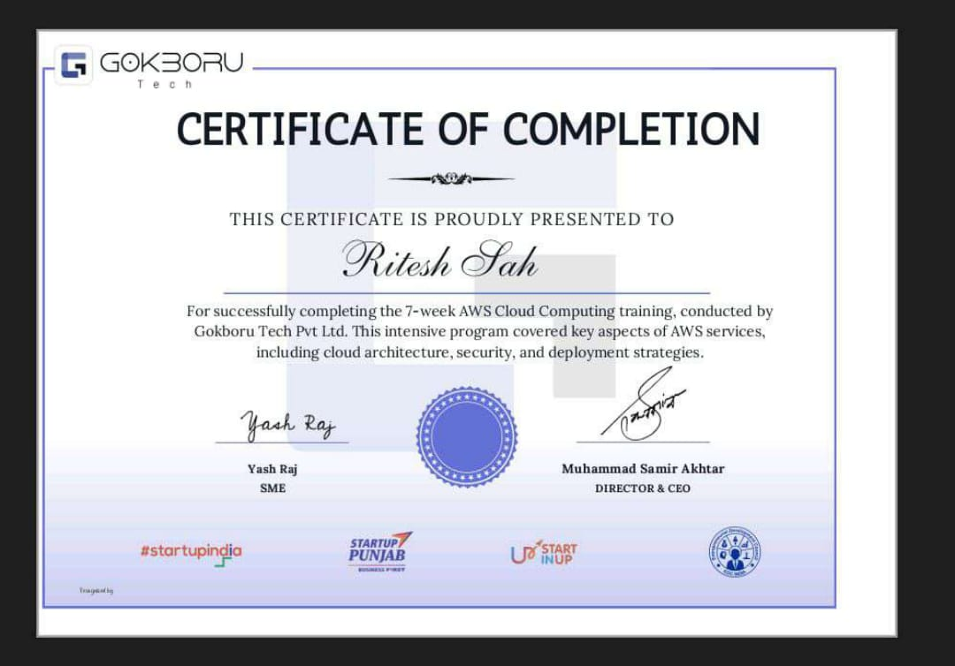
SUMMER TRAINING CERTIFICATE
Summer training certificate by Gokboru Tech Pvt. Ltd. on completing Summer 7-week AWS training.

Slide 4
Reason For Selecting Cloud Computing in AWS
Reason For choosing Cloud Computing
High Demand: Cloud computing experts consistently needed across multiple industries globally.
Lucrative Salaries: Specializing in cloud yields higher salaries due to critical expertise.
Versatility: Cloud skills transferable across sectors; enhances career flexibility and opportunities.
Continuous Innovation: Constant evolution in cloud sector ensures ongoing learning and relevance.
Strategic Impact: Cloud specialists crucial in driving business decisions and digital transformation.

Slide 5
Reason For Selecting Cloud Computing in AWS
Reason for choosing AWS:
Market: AWS has captured 33% of the market worldwide for cloud-computing making it the biggest industry in cloud computing.
Scalable resources: Adjust computing power and storage based on demand without upfront costs.
Global reach: Access AWS services from a broad network of worldwide data centers.
Comprehensive services: Wide range of solutions including computing, storage, databases, and more.
Cost efficiency: Pay only for what you use, avoiding long-term commitments and upfront fees.
Robust security: Data encryption, identity management, and compliance with major security standards.
Innovative technology: Regular updates with new features and seamless integration with various tools.
Reliable performance: High uptime guarantees and disaster recovery options for consistent service availability.

Slide 6
COMMONLY USED AWS SERVICES
Here are some commonly use AWS Services.
EC2 – Scalable virtual servers.
S3 – Object storage for files.
RDS – Managed relational databases.
Lambda – Serverless compute service.
CloudFront – Content delivery network.
IAM – Identity and access management.
VPC – Isolated virtual networks.
Elastic Load Balancer – Distribute traffic across servers.
EBS – Block storage for EC2.
CloudWatch – Monitoring and alerting.
Route 53 – Scalable DNS and domain management.
DynamoDB – NoSQL database service.
Kinesis – Real-time data streaming.
SageMaker – Machine learning service.
SQS – Managed message queuing.
ElastiCache – In-memory caching service.

Slide 7
Project: Monitor Infrastructure with AWS CloudWatch and CloudTrail
Prompt: Analyze the image content and provide a concise summary on monitoring infrastructure with AWS CloudWatch and CloudTrail for a project perspective.
Summary:
AWS CloudWatch and CloudTrail offer comprehensive infrastructure monitoring solutions. CloudWatch tracks metrics, logs, and alarms, providing real-time visibility into resource performance and anomalies. CloudTrail records API calls, enabling auditing, compliance, and troubleshooting. By integrating these services, you can gain valuable insights, optimize resource utilization, and ensure the security and reliability of your AWS infrastructure.
Key benefits:
Real-time monitoring: Track metrics, logs, and alarms for proactive issue identification.
Enhanced visibility: Gain deeper insights into resource performance and utilization.
Improved security: Audit API calls for compliance and detect unauthorized access.
Efficient troubleshooting: Analyze logs to pinpoint and resolve issues quickly.
Integration:
Combine CloudWatch and CloudTrail for a holistic view of your infrastructure.
Utilize CloudWatch Events to trigger actions based on defined conditions.
Leverage CloudWatch Dashboards for customized visualizations and reporting.
By effectively utilizing AWS CloudWatch and CloudTrail, you can establish a robust monitoring framework that supports your project's success and ensures the optimal performance of your AWS infrastructure.

Slide 8
ROADMAP OF Monitor Infrastructure with AWS CloudWatch and CloudTrail
Step 1: First an AWS an account is created and then logged in through using root user.
Step 2: Then A flow Chart is created for creation and understanding for my project
Step 3: For this project we have to create a EC2 instance with tag ec2-1
Step 4: Setting Up AWS CloudWatch with creating the dashboard
Step5: Set Up Alarms and create alarms and with condition of Cpu utilization should be >= 50 and for datapoint within 5 minutes
Step 6: After that we have to choose graph for better understanding
Step 7: We have to set up Alarms and link alarms to actions and add email for receiving message after utilization.
For CloudTrial
Step 1 : Sign in to AWS Management Console Log in to the AWS Management Console.
Step 2: Step 2: Configure CloudTrail
Step3: Review Event History

Slide 9
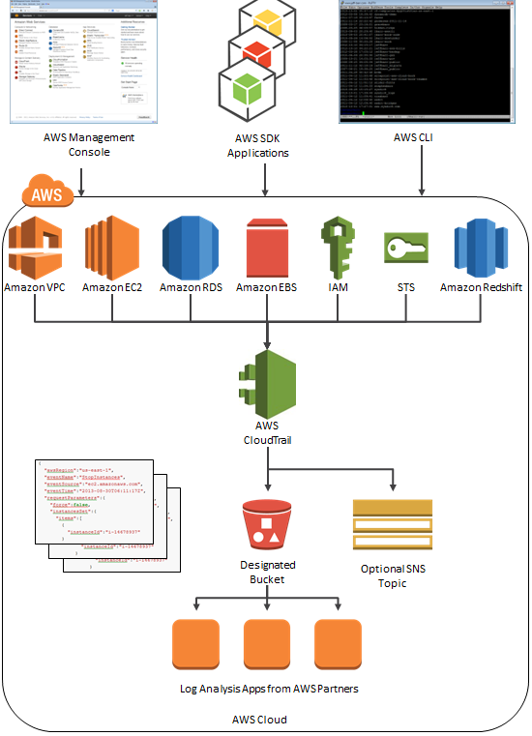
WORKING OF MY PROJECT.
Scenario: A web application hosted on an EC2 instance experiences intermittent performance issues.
CloudWatch and CloudTrail Integration:
CloudWatch Metrics: Set up metrics to monitor CPU utilization, memory usage, and network traffic on the EC2 instance.
CloudWatch Alarms: Create alarms that trigger when metrics exceed thresholds (e.g., CPU usage reaching 90%).
CloudTrail Logging: Enable CloudTrail to record API calls related to the EC2 instance, including configuration changes and resource usage.
CloudWatch Logs Integration: Configure CloudTrail to deliver logs to CloudWatch Logs for analysis.
Correlation and Analysis: Use CloudWatch Logs to search for error messages or unusual patterns in API calls that coincide with performance issues.

Slide 10
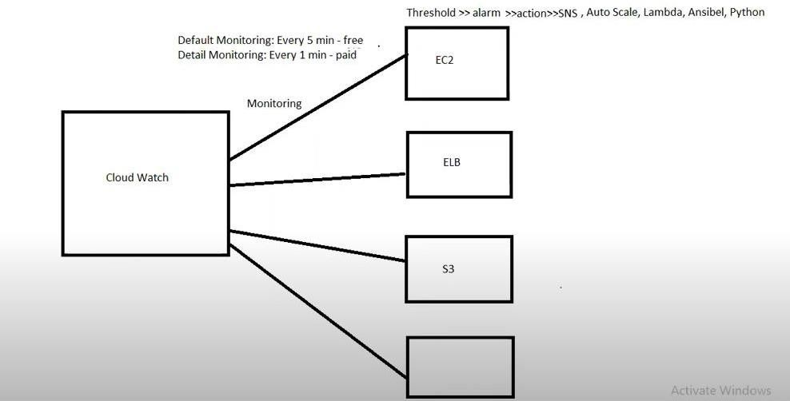
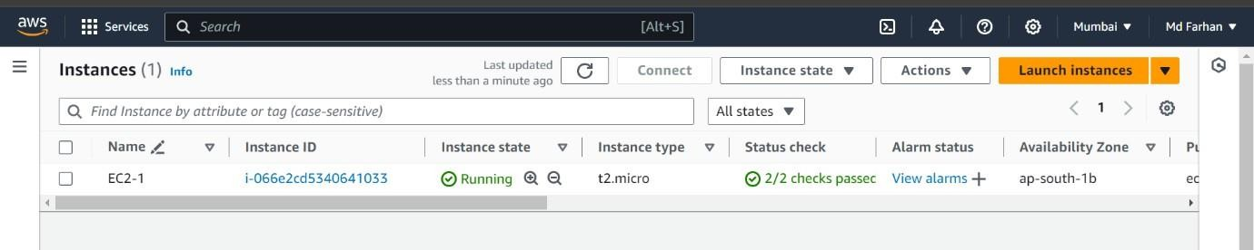
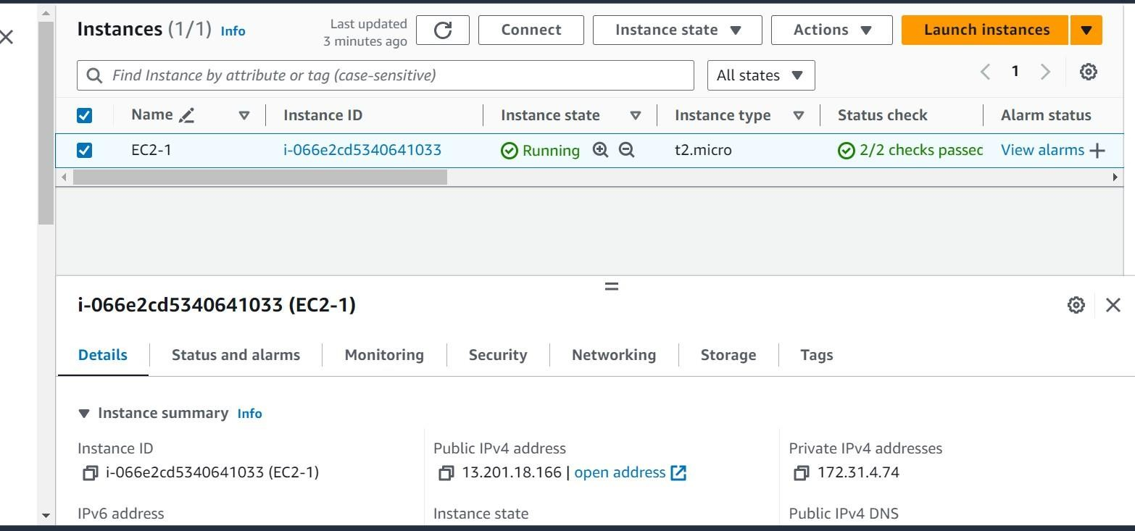
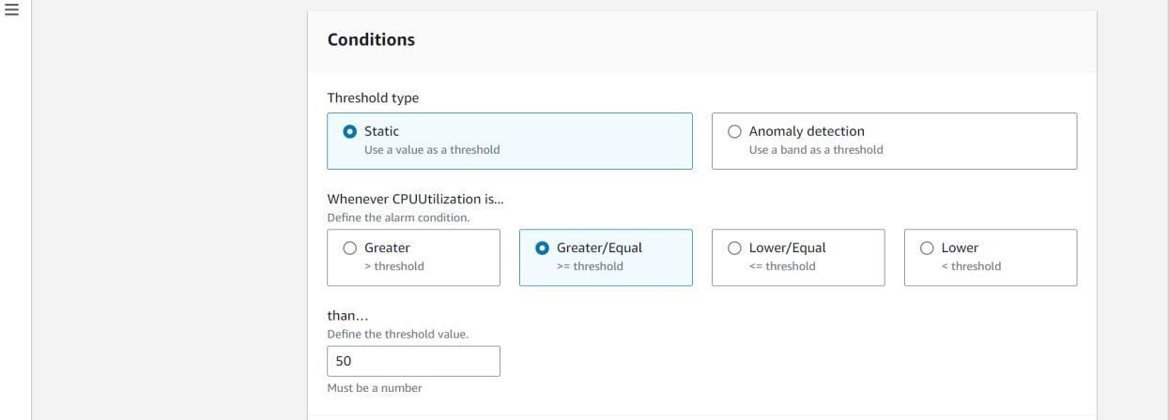
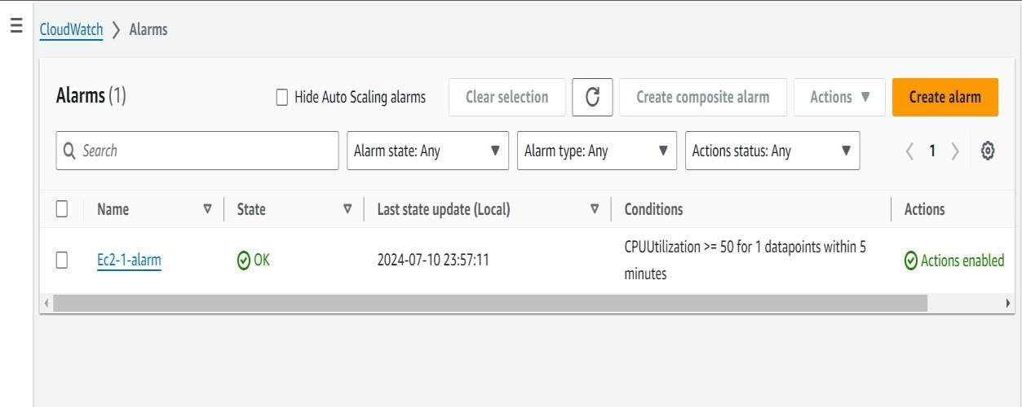
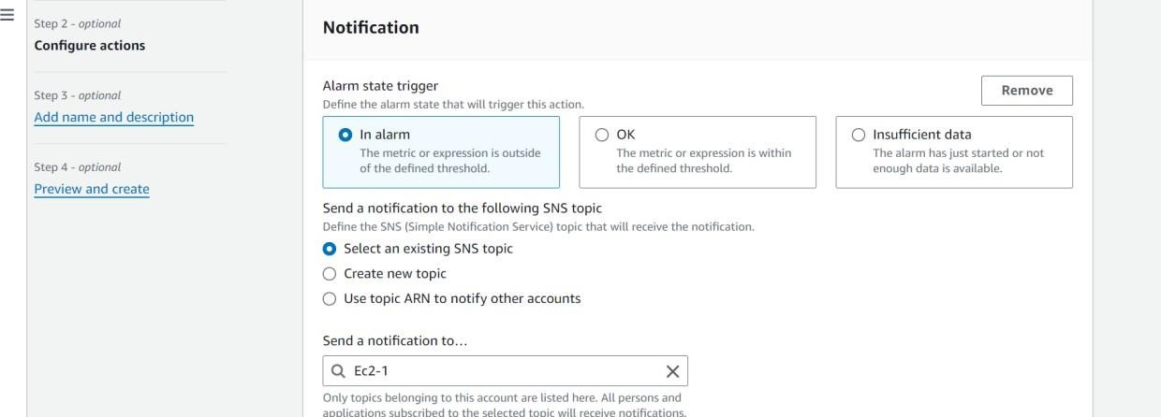
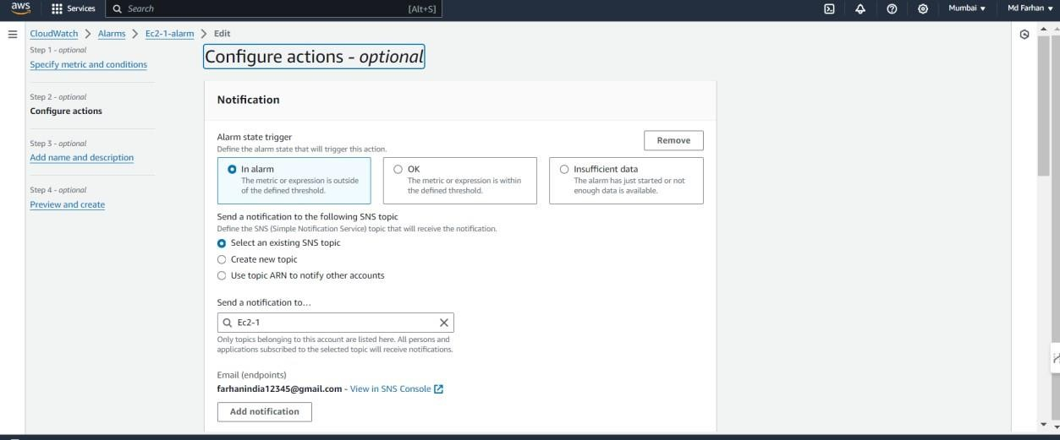
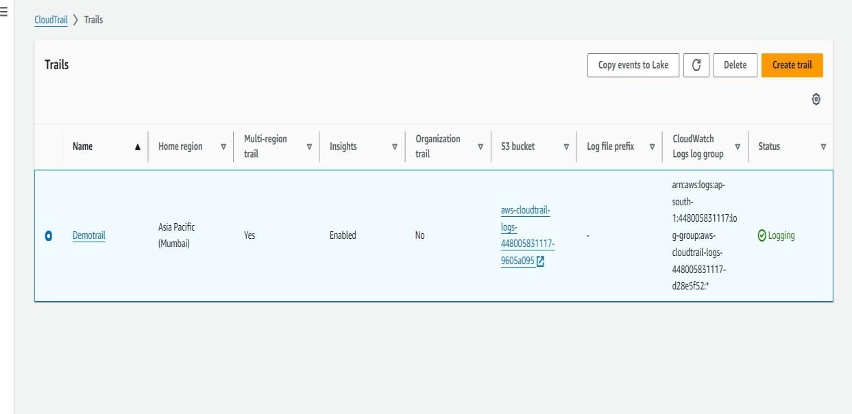
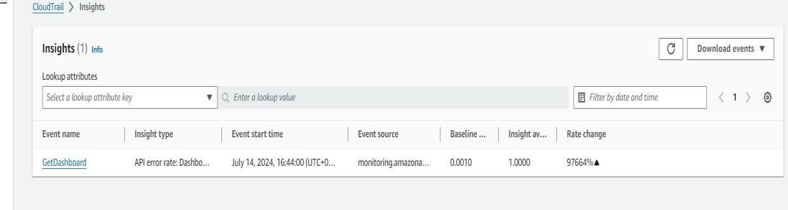
WORKING OF MY PROJECT (CONTD.)
IAM role with policy

Slide 11
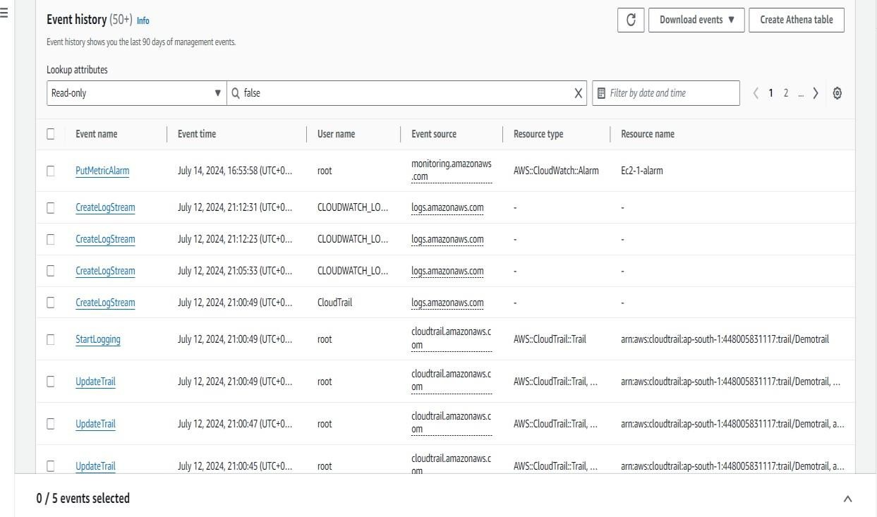
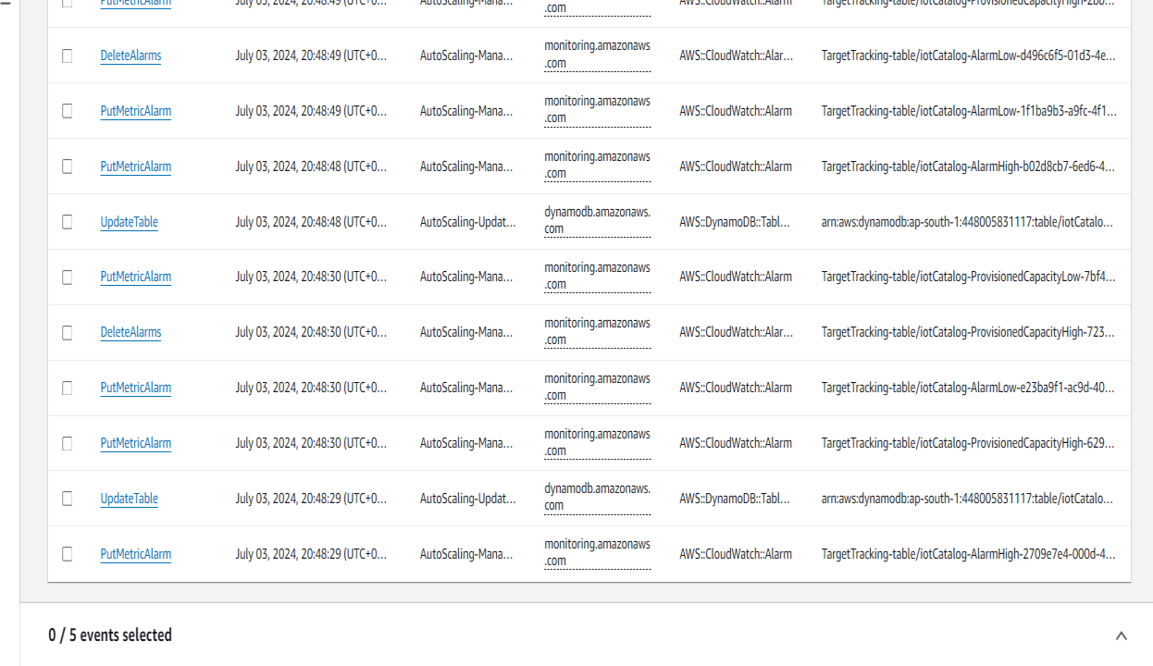
Review Event History

Slide 12
Real-Life Applications of AWS CloudWatch and CloudTrail
E-commerce: Track website traffic, sales data, and customer behavior.
Gaming: Analyze player behavior, game performance, and identify cheating.
Financial Services: Monitor stock prices, transaction volumes, and fraud detection.
Healthcare: Track medical device performance, patient data, and compliance.
Media and Entertainment: Monitor streaming services, content delivery, and user engagement.
Example: A large-scale online gaming company uses CloudWatch to monitor game server performance, identify bottlenecks, and ensure a smooth player experience. CloudTrail is used to audit game server configurations and detect any unauthorized access attempts.
Another example: A healthcare provider uses CloudWatch to monitor the performance of medical devices and ensure data integrity. CloudTrail is used to audit access to patient records and comply with HIPAA regulations.
By effectively utilizing AWS CloudWatch and CloudTrail, businesses can gain valuable insights, improve operational efficiency, and ensure the security and reliability of their AWS infrastructure.

Slide 13
THANK YOU! HAVE A NICE DAY!

